Slide 1
UEFI Writers Lab
Intel Corporation
Software and Services Group

Slide 2
Agenda
Local System setup
  Microsoft Installation Same as for Framework Build lab
  Framework EDK
  EFI toolkit
Build the Toolkit and Framework EDK
Directories for Toolkit and Framework EDK
Run in the Framework EDK NT32 environment
Run simple shell commands in NT32 environment
Create EFI application from toolkit and run in NT32 Framework EDK
Write a EFI Driver
Use EFI debug for debugging environment
Notes:
First of which, I’ll give you an overview of what the build process is really about.
Then, I’m going to show you the Framework directory structure.
After that, the build environment must be configured, and that involves few steps.
When the environment is ready, I will go about how to make the binaries and generate the ROM image
Finally, I think it goes without saying, you will often encounter problems when building the Framework. I’ll troubleshoot some common problems that one may experience.
40

Slide 3
Local System Setup
Local System Setup
  Microsoft Studio Setup
    Install Microsoft Visual Studio .NET 2003 or MSVC 2005 (also done for Building the Framework)
    From Command prompt type VCVARS32
  EDK NT32
    The only environmental variable that must be defined for building the various Framework platforms (build tips) is EDK_SOURCE
    Set EDK_SOURCE=C:\FW\Edk
  EFI Toolkit will use the Command batch file from the top level toolkit directory
    BUILD.CMD

Slide 4
Build EFI toolkit and Framework EDK
Done
Build the NT32 Framework environment (done in previous class)
  C:\FW\Edk\Sample\Platform\Nt32\Build>
  set EDK_SOURCE=C:\FW\EDK
  C:\FW\Edk\Sample\Platform\Nt32\>
  Build
Building the EFI toolkit for NT32
Copy the From the Class CD
Unzip the EFI Toolkit 2.0 from the CD EFI_WritersLAB to C:\Fw
Go to VS command prompt
  Vcvars32
  cd \FW\efi_toolkit_20
  For MSVS 2005 - Edit the SDK.ENV file under the dir BUILD\Nt32 add compile option “/GS-” for C_BUILD_FLAGS
    C_BUILD_FLAGS=/nologo /W3 /GS- /Gm /Zi /Od /GF /Gy /QIfist /Gs8192
    OR Copy sdkVS2005.env to Build\Nt32\SDK.Env
  build NT32
  Nmake

Slide 5
Agenda
Local System setup
  Microsoft Installation Same as for Framework Build lab
  Framework EDK
  EFI toolkit
Build the Toolkit and Framework EDK
Directories for Toolkit and Framework EDK
Run in the Framework EDK NT32 environment
Run simple shell commands in NT32 environment
Create EFI application from toolkit and run in NT32 Framework EDK
Write a EFI Driver
Use EFI debug for debugging environment
Notes:
First of which, I’ll give you an overview of what the build process is really about.
Then, I’m going to show you the Framework directory structure.
After that, the build environment must be configured, and that involves few steps.
When the environment is ready, I will go about how to make the binaries and generate the ROM image
Finally, I think it goes without saying, you will often encounter problems when building the Framework. I’ll troubleshoot some common problems that one may experience.
40

Slide 6
EFI Toolkit Directory Structure
EFI Toolkit
  This section provides an overview of the Toolkit directory structure. The root of the Toolkit source tree contains the primary directories that are listed in Table below.
Root Directory of Toolkit Source Tree
Apps | EFI sample applications.
binaries | Binaries built from the source
Build | Build environment directories
cmds | Ports of FreeBSD commands and utilities
Doc | Documentation for the EFI Application Toolkit
Include | Common include files
Lib | Common libraries
Protocols | Toolkit-supplied EFI protocols and drivers

Slide 7
The EDK Directory Tree
Directory Structure
EDK
  Foundation
    Core
    CPU
    EFI
    Framework
    GUID
    Include
    Library
    Ppi
    Protocol
  Sample
    Bus
    Chipset
    CPU
    Include
    Library
    Platform
    Tools
    Universal
  Other
    Maintained
    Non-Maintained
The EDK directory contains all of the source necessary to build the NT32 platform tip. This is the open source project that is located at TianoCore.Org. This directory does not include all of the Framework source.
  The EDK subdirectories follow the same hierarchy of the Framework Subdirectories.

Slide 8
Agenda
Local System setup
  Microsoft Installation Same as for Framework Build lab
  Framework EDK
  EFI toolkit
Build the Toolkit and Framework EDK
Directories for Toolkit and Framework EDK
Run in the Framework EDK NT32 environment
Run simple shell commands in NT32 environment
Create EFI application from toolkit and run in NT32 Framework EDK
Write a EFI Driver
Use EFI debug for debugging environment
Notes:
First of which, I’ll give you an overview of what the build process is really about.
Then, I’m going to show you the Framework directory structure.
After that, the build environment must be configured, and that involves few steps.
When the environment is ready, I will go about how to make the binaries and generate the ROM image
Finally, I think it goes without saying, you will often encounter problems when building the Framework. I’ll troubleshoot some common problems that one may experience.
40

Slide 9
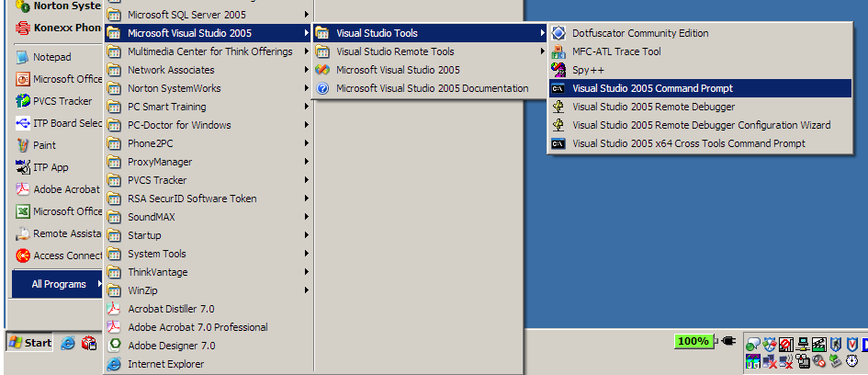
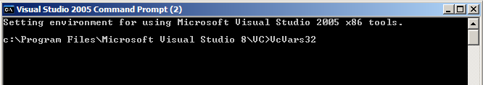
Set up the Environment
Use the Visual Studio command prompt to setup the proper compiler environment
Run VcVars32 at the CMD Window with VS 2005
3
4
5
2
6
1

Slide 10
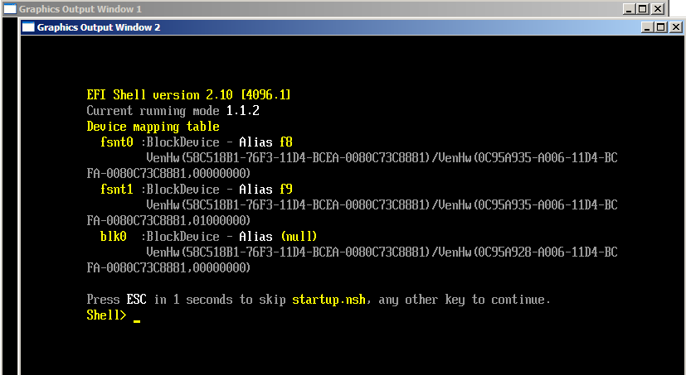
Run the EDK Framework NT32
Run the NT32 Framework environment
  > set EDK_SOURCE=C:\FW\EDK
  > Cd C:\fw\Edk\Sample\Platform\Nt32\Uefi
  > System
  > nmake run
  Reset – command to EXIT shell

Slide 11
Agenda
Local System setup
  Microsoft Installation Same as for Framework Build lab
  Framework EDK
  EFI toolkit
Build the Toolkit and Framework EDK
Directories for Toolkit and Framework EDK
Run in the Framework EDK NT32 environment
Run simple shell commands in NT32 environment
Create EFI application from toolkit and run in NT32 Framework EDK
Write a EFI Driver
Use EFI debug for debugging environment
Notes:
First of which, I’ll give you an overview of what the build process is really about.
Then, I’m going to show you the Framework directory structure.
After that, the build environment must be configured, and that involves few steps.
When the environment is ready, I will go about how to make the binaries and generate the ROM image
Finally, I think it goes without saying, you will often encounter problems when building the Framework. I’ll troubleshoot some common problems that one may experience.
40

Slide 12
Execute Applications in the Framework EDK NT32 environment
The following exercise will demonstrate that the EFI toolkit applications can be run in the NT32 environment.
Copy the file EDIT.EFI from EFI toolkit directory: C:\FW\EFI_Toolkit_2.0\build\nt32\bin
to the Framework EDK NT32 Bin directory C:\FW\Edk\Sample\platform\nt32\uefi\IA32
New CMD prompt (Use the Visual Studio command prompt to setup the proper compiler environment )
Cd FW\Edk\Sample\platform\nt32\Uefi
Set EDK_SOURCE=C:\FW\Edk
System.cmd

Slide 13
Execute Applications in the Framework EDK NT32 environment (continued)
Nmake Run
Select the EFI shell boot option
Fsnt0: or F8:
Dir EDIT.EFI
EDIT Test.txt > this is an EFI application compiled with the toolkit and running in the Framework EDK
Type a few lines then save and exit EDIT with F3

Slide 14
Agenda
Local System setup
  Microsoft Installation Same as for Framework Build lab
  Framework EDK
  EFI toolkit
Build the Toolkit and Framework EDK
Directories for Toolkit and Framework EDK
Run in the Framework EDK NT32 environment
Run simple shell commands in NT32 environment
Create EFI application from toolkit and run in NT32 Framework EDK
Write a EFI Driver
Use EFI debug for debugging environment
Notes:
First of which, I’ll give you an overview of what the build process is really about.
Then, I’m going to show you the Framework directory structure.
After that, the build environment must be configured, and that involves few steps.
When the environment is ready, I will go about how to make the binaries and generate the ROM image
Finally, I think it goes without saying, you will often encounter problems when building the Framework. I’ll troubleshoot some common problems that one may experience.
40

Slide 15
Writing a EFI Application with the EFI toolkit
Standard EFI entry point
  typedef EFI_STATUS
  (EFIAPI *EFI_IMAGE_ENTRY_POINT(
  IN EFI_HANDLE ImageHandle,
  IN EFI_SYSTEM_TABLE *SystemTable
  );
Portability entry point
  int
  main( int argc, char **argv ); // _LIBC_Start_Shellapp_A
  int
  main( int argc, wchar_t **argv ); // _LIBC_Start_Shellapp_U
Portability special exit
  void
  _LIBC_EfiExit(
  IN EFI_STATUS Status,
  IN UINTN DataSize,
  IN CHAR16 *ExitData
  );

Slide 16
LAB
Cd \FW\EFI_Toolkit_2.0\apps
Create a directory HELLO
Create a hello.mak (add contains of hello.mak in CD \Class\Toolkit\hello)
#The contents of hello.mak are listed below.
!include $(SDK_INSTALL_DIR)\build\$(SDK_BUILD_ENV)\sdk.env
BASE_NAME = hello
IMAGE_ENTRY_POINT = InitializeHelloApplication
# Globals needed by master.mak
TARGET_APP = $(BASE_NAME)
SOURCE_DIR = $(SDK_INSTALL_DIR)\apps\$(BASE_NAME)
BUILD_DIR = $(SDK_BUILD_DIR)\apps\$(BASE_NAME)
# Include paths

Slide 17
LAB (cont’d)
HELLO.MAK
!include $(SDK_INSTALL_DIR)\include\$(EFI_INC_DIR)\makefile.hdr
INC = -I $(SDK_INSTALL_DIR)\include\$(EFI_INC_DIR) \
-I $(SDK_INSTALL_DIR)\include\$(EFI_INC_DIR)\$(PROCESSOR) $(INC)
all : dirs $(LIBS) $(OBJECTS)
# Program object files
OBJECTS = $(OBJECTS) $(BUILD_DIR)\$(BASE_NAME).obj
# Source file dependencies
$(BUILD_DIR)\$(BASE_NAME).obj : $(*B).c $(INC_DEPS)
# Handoff to master.mak
!include $(SDK_INSTALL_DIR)\build\master.mak

Slide 18
LAB (cont’d)
Create a hello.c file (add hello.c in CD \Class\Toolkit\hello)
  Without Library
/*++
Copyright (c) 2004 Intel Corporation
Module Name:
hello.c
Abstract:
Author:
Revision History
--*/
#include "efi.h"
EFI_STATUS
InitializeHelloApplication (
IN EFI_HANDLE ImageHandle,
IN EFI_SYSTEM_TABLE *SystemTable
)

Slide 19
LAB (cont’d)
HELLO.C
{
UINTN Index;
//
// Send a message to the ConsoleOut device.
//
SystemTable->ConOut->OutputString(SystemTable->ConOut,
L"Hello application started\n\r");
//
// Wait for the user to press a key.
//
SystemTable->ConOut->OutputString(SystemTable->ConOut,
L"\n\r\n\r\n\rHit any key to exit\n\r");
SystemTable->BootServices->WaitForEvent (1,
&(SystemTable->ConIn->WaitForKey),
&Index);
SystemTable->ConOut->OutputString(SystemTable->ConOut,L"\n\r\n\r");
//
// Exit the application.
//
return EFI_SUCCESS;
}

Slide 20
LAB (cont’d)
Edit the file in apps dir Apps.mak and add the hello.mak to the build (See EFI_CLASS_EDIT)
  . . .
  cd $(SOURCE_DIR)\hello
  nmake -f hello.mak all
  cd $(SOURCE_DIR)
  . . .
cd \FW\efi_toolkit_2.0
build NT32
Nmake
Copy the file HELLO.EFI from EFI toolkit directory \FW\EFI_Toolkit_2.0\build\nt32\bin to the Framework EDK NT32 Bin directory FW\Edk\Sample\platform\nt32\uefi\IA32

Slide 21
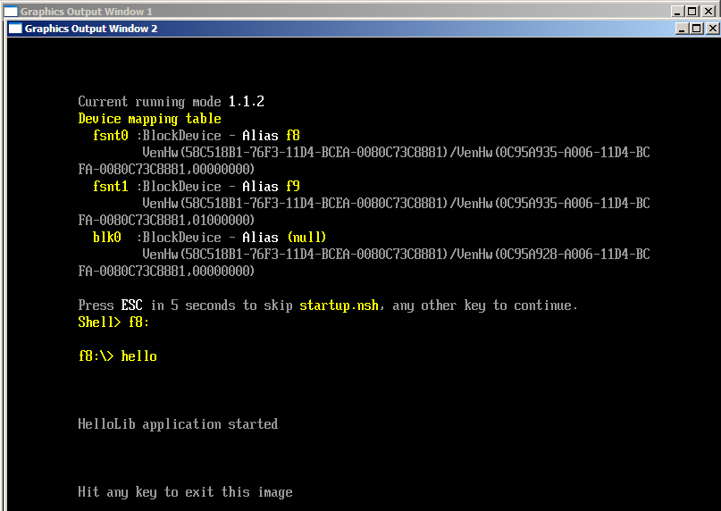
LAB (cont’d)
Run the Framework EDK NT32 and test the HELLO.EFI application
  Cd FW\Edk\Sample\platform\nt32\Uefi
  Nmake Run
  Fsnt0: or F8:
  >hello

Slide 22
LAB EFI Application using Library
  Try the same steps to build “Hello” With Library
    hellol.c in CD \Class\Toolkit\hello
    Notice that the “C” file is much shorter
#include "efi.h"
#include "efilib.h"
EFI_STATUS
InitializeHelloLibApplication (
IN EFI_HANDLE ImageHandle,
IN EFI_SYSTEM_TABLE *SystemTable
)
{
InitializeLib (ImageHandle, SystemTable);
Print(L"\n\n\nHelloLib application started\n\n\n");
Print(L"\nHit any key to exit this image\n");
WaitForSingleEvent(ST->ConIn->WaitForKey,0);
ST->ConOut->OutputString (ST->ConOut, L"\n\r\n\r");
return EFI_SUCCESS;
}

Slide 23
Extra Credit Lab
On the CD under the directory \Class\Customize there are 2 other implementations of “HelloWorld”
Add both of these to your NT32 Build – hint – look at the Nt32h.dsc file on the CD \Class\Customize
Another hint – look at the HelloWorldReleaseNotes.txt file on the CD in the Dir \Class\Customize

Slide 24
Agenda
Local System setup
  Microsoft Installation Same as for Framework Build lab
  Framework EDK
  EFI toolkit
Build the Toolkit and Framework EDK
Directories for Toolkit and Framework EDK
Run in the Framework EDK NT32 environment
Run simple shell commands in NT32 environment
Create EFI application from toolkit and run in NT32 Framework EDK
Write a EFI Driver
Use EFI debug for debugging environment
Notes:
First of which, I’ll give you an overview of what the build process is really about.
Then, I’m going to show you the Framework directory structure.
After that, the build environment must be configured, and that involves few steps.
When the environment is ready, I will go about how to make the binaries and generate the ROM image
Finally, I think it goes without saying, you will often encounter problems when building the Framework. I’ll troubleshoot some common problems that one may experience.
40

Slide 25
Write an EFI Driver
Driver Binding Protocol
  Supported()
    Checks to see if a driver supports a controller
    Check should not change hardware state of controller
    Minimize execution time, move complex I/O to Start()
    May be called for controller that is already managed
    Child is optionally specified
  Start()
    Starts a driver on a controller
    Can create ALL child handles or ONE child handle
    A driver is not required to support starting ONE child handle. It may always create ALL child handles.
  Stop()
    Stops a driver from managing a controller
    Destroys all specified child handles
    If no children specified, controller is stopped
    Stopping a bus controller requires 2 calls

Slide 26
1. Create directories
Driver Directory
  Add a directory under Edk\Sample\Bus\PCI
  Name that directory for your driver
    SampleDrv in this example
Protocol Directory
  Add a directory under EDK\Foundation\Protocol
  Name that directory for your driver
    SampleDrv in this example

Slide 27
File Recommendations
Driver.c
DriverEntryPoint()
Unload()
NotifyExitBootServices()
NotifySetVirtualAddressMap()
Supported()
Start()
Stop()
Produced Protocol Functions
ComponentName.c
DriverConfiguration.c
DriverDiagnostics.c
Driver.h
Make.inf

Slide 28
File Recommendations
Driver.c
ComponentName.c
GetDriverName()
GetControllerName()
DriverConfiguration.c
DriverDiagnostics.c
Driver.h
Make.inf

Slide 29
File Recommendations
Driver.c
ComponentName.c
DriverConfiguration.c
Query()
Response()
DriverDiagnostics.c
Driver.h
Make.inf

Slide 30
File Recommendations
Driver.c
ComponentName.c
DriverConfiguration.c
DriverDiagnostics.c
RunDiagnostics()
Driver.h
Make.inf

Slide 31
File Recommendations
Driver.c
ComponentName.c
DriverConfiguration.c
DriverDiagnostics.c
Private Context Structure
Global Variable Declarations
Function Prototypes
Driver.h
Make.inf

Slide 32
File Recommendations
Driver.c
ComponentName.c
DriverConfiguration.c
DriverDiagnostics.c
Source Files
Libraries
Driver Entry Point
BootService or Runtime Driver
Driver.h
Make.inf

Slide 33
File Recommendations
Driver.c
Low Complexity Drivers
  4 Functions
  1 Data Structure Designed
Medium Complexity Drivers
  7 Functions
  1 Data Structure Designed
High Complexity Drivers
  14 Functions
  1 Data Structure
Very High Complexity Drivers
  20+ Functions
  3+ Data Structures Designed
ComponentName.c
DriverConfiguration.c
DriverDiagnostics.c
Driver.h
Make.inf

Slide 34
2. Adding files
Add files to the driver directory (step 1)
  SampleDrv.c, SampleDrv.h, ComponentName.c, Make.inf are part of every driver.
  DriverDiagnostics.c and DriverConfiguration.c are not required in your driver.
  Look on the CD \Class\SampleDrv\SampleDrv for the files for the demonstration.
Add files to the protocol directory
  SampleDrv.c, SampleDrv.h
  Look on the CD \Class\SampleDrv\Protocol for the files for the demonstration.

Slide 35
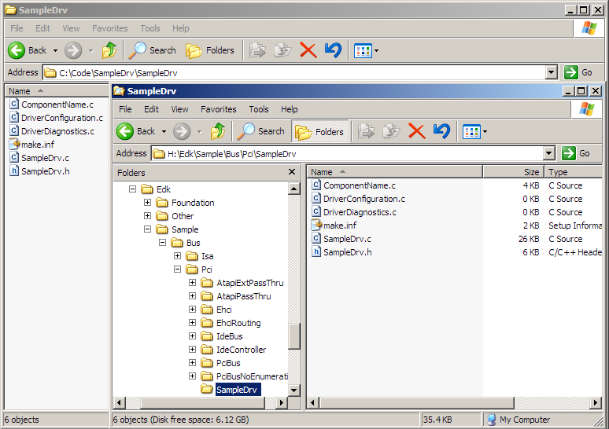
2. Details Copy Driver Files
Create the Directory SampleDrv under Sample\Bus\PCI and copy the files
D:\class\SampleDrv\SampleDrv

Slide 36
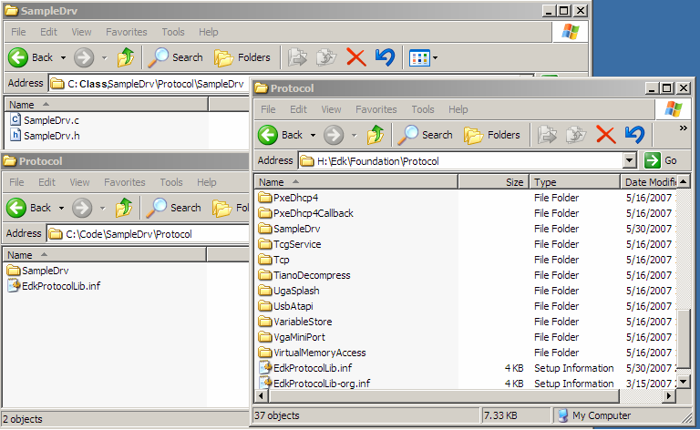
2. Details Copy Protocol Files
D:\class\SampleDrv\Protocol\SampleDrv
D:\class
Create Dir SampleDrv under the EDK\Foundation\Protocol Dir “NOTE: Protocol files are different than the Driver files on previous slide”

Slide 37
3. INF files
Defines the build options for the driver
  Image Entry Point
  Required libraries
  Include directories
Only 1 resides in the driver’s directory
  Sample driver example has a “make.inf” file

Slide 38
3. Details INF Example
Unique GUID
[defines]
BASE_NAME = SampleDrv
FILE_GUID = 5bc2ba35-838b-42bc-acb8-ec3c76168fce
COMPONENT_TYPE = BS_DRIVER
[sources.common]
SampleDrv.c
SampleDrv.h
[libraries.common]
EdkGuidLib
EdkProtocolLib
EfiProtocolLib
EfiDriverLib
[includes.common]
$(EDK_SOURCE)\Foundation
$(EDK_SOURCE)\Foundation\Efi
$(EDK_SOURCE)\Foundation\Framework
[nmake.common]
IMAGE_ENTRY_POINT=InitializeSampleDrvDriver
Entry Point

Slide 39
4. Updating DSC file
Master DSC is updated so that the automated build process knows that the driver exists.
It will then call into the inf for your driver.
Look for #DriverTraining in the .DSC file in the CD Class\SampleDrv\DSC\NT32.DSC directory.

Slide 40
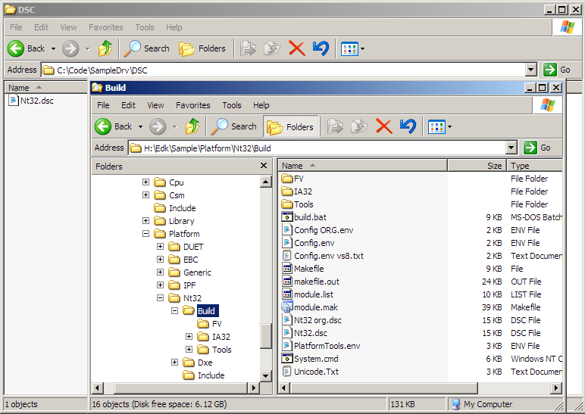
4. Details Nt32.DSC
D:\class

Slide 41
4. Details DSC Example
Sample\Bus\Usb\UsbMouse\Dxe\UsbMouse.inf
Sample\Universal\Network\PxeBc\Dxe\BC.inf
Sample\Universal\Network\PxeDhcp4\Dxe\Dhcp4.inf
Sample\Universal\Network\Snp32_64\Dxe\SNP.inf
#DriverTraining
Sample\Bus\PCI\SampleDrv\make.inf FV=NULL

Slide 42
5. Custom protocols
Add the protocol files to the protocol directory
Update the EdkProtocolLib.inf with:
  sampleDrv\SampleDrv.c
  sampleDrv\SampleDrv.h
  Now some image could use (consume or produce) your protocols

Slide 43
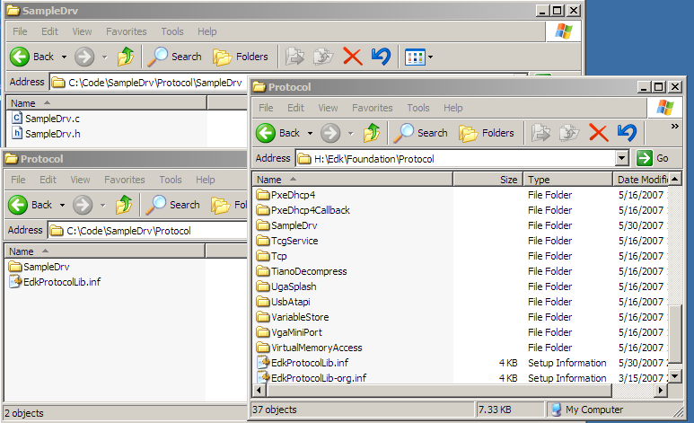
5. Details - EdkProtocolLib.INF File
D:\class
D:\class

Slide 44
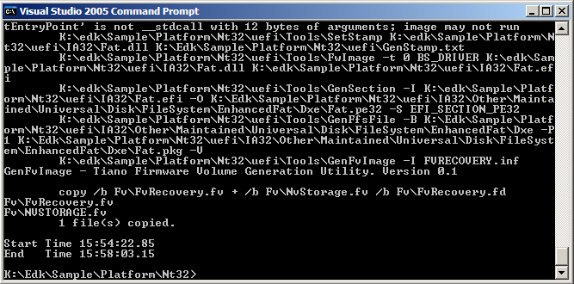
6. Test building driver
Go back to VS.NET command prompt
  set EDK_SOURCE=C:\FW\EDK
  Cd C:\fw\Edk\Sample\Platform\Nt32
  Build
Build Time stamp

Slide 45
7. Load the driver
Go back to VS.NET command prompt
  >Cd Uefi
  >System
  >Nmake run
  >Fsnt0:
  >Load Sampledrv.efi
  >Dh
The –b option stops at each page break in the EFI shell.
The SampleDrv should be loaded at the end

Slide 46
Next Steps - Lab
How do you see which child process are managed by your driver?
What if your driver does not manage anything?
How would you “unload” the driver?

Slide 47
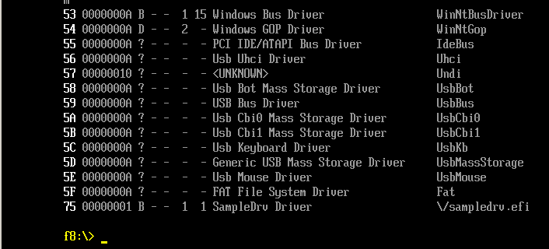
Which child process are managed by your driver
The EFI shell command “drivers” will show if the driver is managing anything
  >drivers
This tells us the driver is
managing a child process

Slide 48
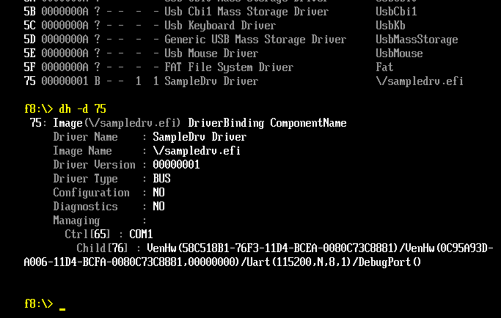
Which child process are managed by your driver
The “dh” command with “–d #” option will show further details
  >dh –d 75
  Using the
  Handle number
  in your
  emulation
Notice that the COM1 resource is being managed by the SampleDrv

Slide 49
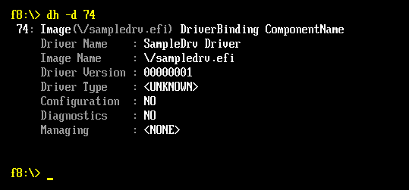
Which child process are managed by your driver
Why would your driver not manage anything?
  >dh –d 74
If something else has taken the resource then the driver will not manage
  Example – If Hyper-terminal is on COM1
  No COM port on your laptop

Slide 50
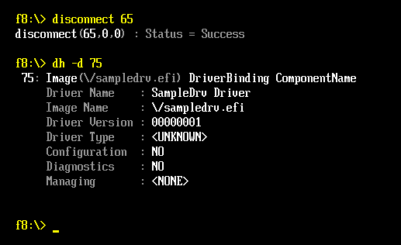
How would you “unload” the driver
The “disconnect” command will remove the child processes managed by the driver
  >disconnect 76
  >disconnect 65
  >dh –d 75
Notice that there is nothing managed by the Driver after the disconnect.

Slide 51
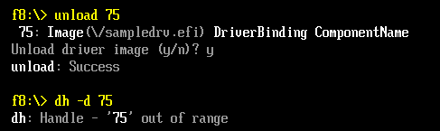
How would you “unload” the driver
Use the EFI Shell “unload” command to unload the driver from the driver handle data base.
  >unload 75
Notice that the handle has been removed

Slide 52
Agenda
Local System setup
  Microsoft Installation Same as for Framework Build lab
  Framework EDK
  EFI toolkit
Build the Toolkit and Framework EDK
Directories for Toolkit and Framework EDK
Run in the Framework EDK NT32 environment
Run simple shell commands in NT32 environment
Create EFI application from toolkit and run in NT32 Framework EDK
Write a EFI Driver
Use EFI debug for debugging environment
Notes:
First of which, I’ll give you an overview of what the build process is really about.
Then, I’m going to show you the Framework directory structure.
After that, the build environment must be configured, and that involves few steps.
When the environment is ready, I will go about how to make the binaries and generate the ROM image
Finally, I think it goes without saying, you will often encounter problems when building the Framework. I’ll troubleshoot some common problems that one may experience.
40

Slide 53
How to Debug using Visual Studio
Edit the file “SampleDrv.c” in the Edk\Sample\Bus\Pci\SampleDrv directory and uncomment the “EFI_BREAKPOINT();” Macro (line 86)
Go back to VS.NET command prompt
  >Cd C:\fw\Edk\Sample\Platform\Nt32 (CD..)
  >Build
  >cd Uefi
  >Nmake run
  >Fsnt0:
  >Load SampleDrv.efi
The Visual Studio debug Screen will prompt at the Breakpoint

Slide 54
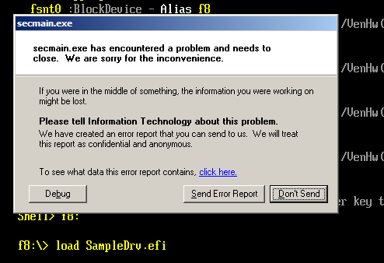
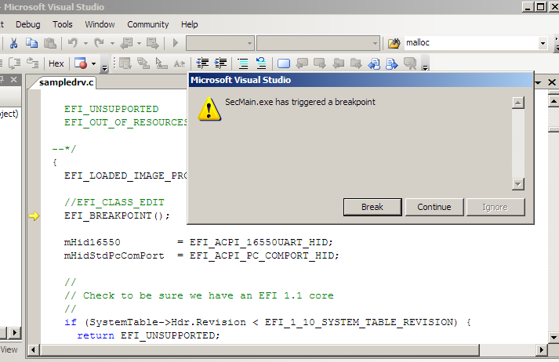
How to Debug using Visual Studio
Select “Debug”
Then “Break”
Now Visual Studio can be used for debugging
Notice the Driver source
code is brought into the
Visual Studio
Use “F10” to Step over

Slide 55
Summary
Debug an EFI application or framework driver just like a normal Windows application
  Debug applications in Visual Studio
  Continue running the application to next breakpoint
  Quick turnaround to verify a fix
  Exit emulation
  Modify code, recompile and launch application
Modularity
  Binary compatibility of framework between platforms allows for new development environment supporting modern software practices.
Reduce Time To Market (TTM)
  Development and test of hardware independent portions with modern and common tools.
  Allows vendors to share drivers and applications

Slide 56
Additional Resources
Class CD - Documents
  UEFI DWGprelim.pdf UEFI Drivers Writer’s guide
https://www.TianoCore.org
  Website for EFI open source resources
    EFI Developer Kit (EDK)
      Nt32 emulation environment
    EFI Toolkit https://efi-toolkit.tianocore.org/

Slide 57




Q & A

Slide 58


Slide 59

Back up
Back Up

